Slide 1
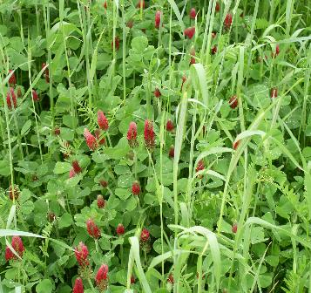
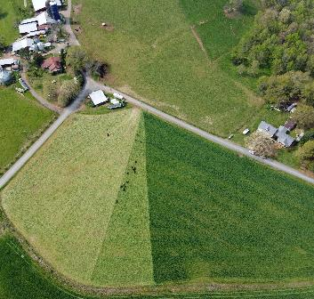
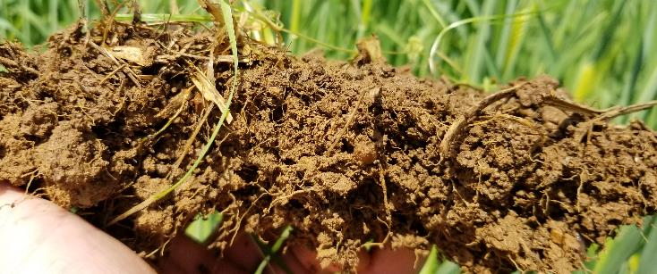
Cover Crops for Soil Health
Soil Health Division
Notes:
Photo credit: Nathan Lowder NRCS SHD

Slide 2
Participant Introductions
Name or alias
Brief Background
Current position
Where do cover crops fit in your day-to-day activities?

Slide 3
Course Goals
Expansion of current Soil Health and Sustainability Course module content
Complete class activities that support cover crop implementation
Provide technical materials to support successful conservation planning
Work through logistics of practical implementation

Slide 4
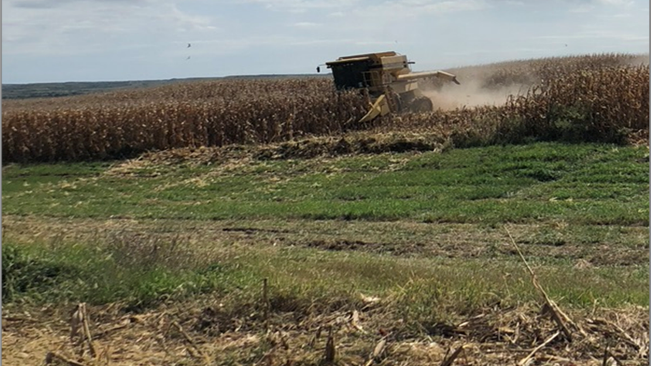
Why do we use cover crops?

Slide 5
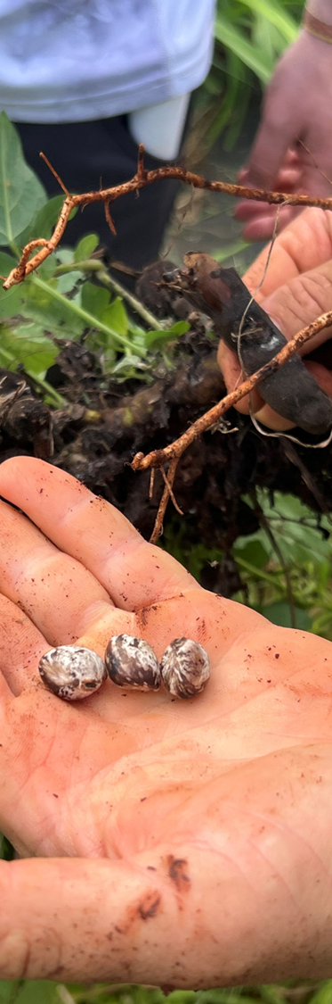
Farmer’s Top Three Reasons for Cover Crop adoption
Increase soil organic matter
Reduce erosion
Suppress weeds
Notes:
Review paper by Baraibar et al.. 2018

Slide 6
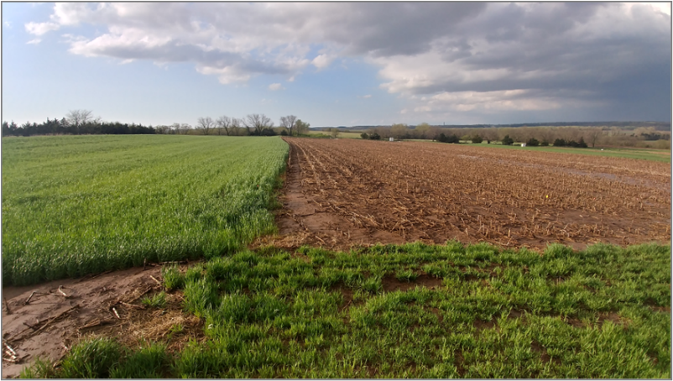
Cover Crops and Water Quality
CC can reduce runoff volume by 10-98%
CC can reduce erosion by 20-100%
CC can reduce nitrate leaching by 18-95%
Grass CC can reduce weed pressure and herbicide applications
Source: Blanco-Canqui, 2018

Slide 7
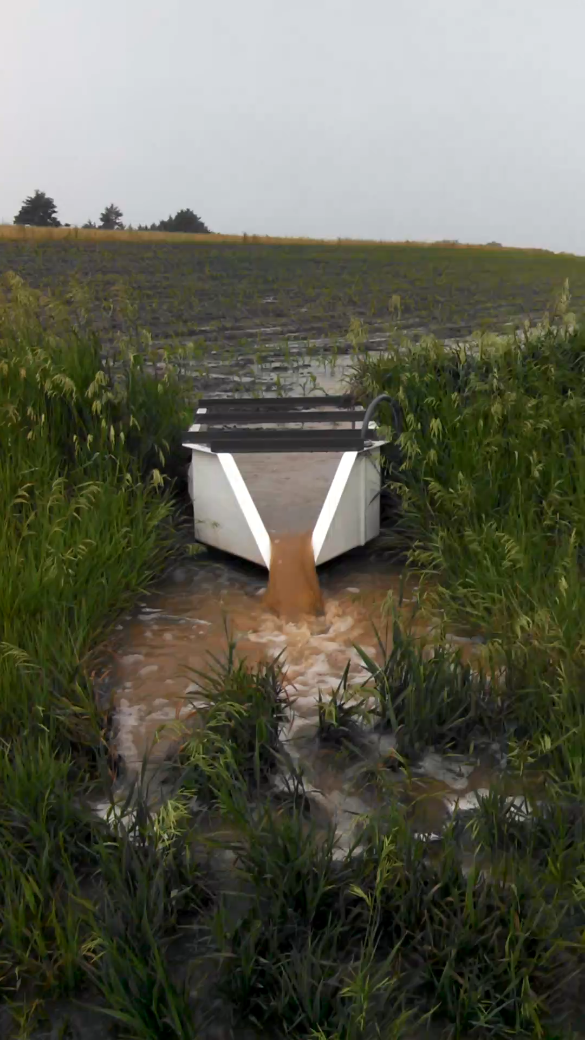
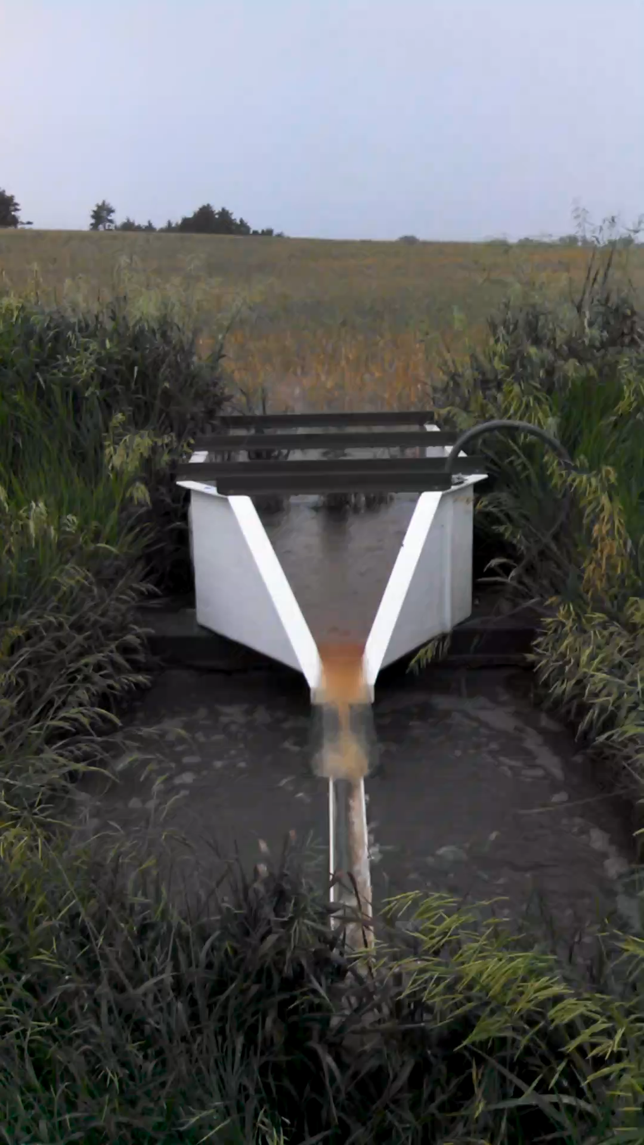
Cover Crops and Water Quality (cont)
Videos are taken at the same site, same time
Only difference was a triticale and rapeseed cover crop
Videos used with permission by Dr. Nathan Nelson

Slide 8
Cover Crops and Pest Suppression
CC can increase microbial abundance by 27%, activity by 22% and diversity by 2.5% (Kim, 2020)
Cereal Rye reduced weed density and biomass by >90% (Appelgate 2017)
Cereal rye reduced thrip and stink bug boll pressure in cotton, and maintained higher diversity of pest predators (Bowers 2020)

Slide 9
Cover Crops and Pest Suppression (cont)
Fast emergence
Rapid growth
Rapid soil coverage

Slide 10
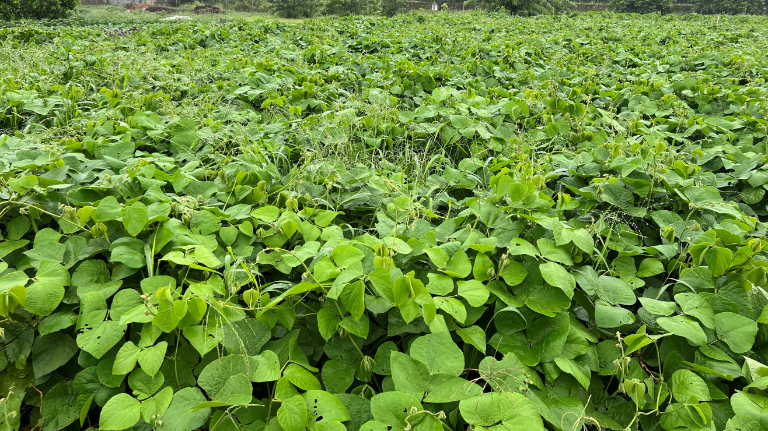
How do we match the cover crop to our goals?

Slide 11
Cover Crop Exercise
Understanding cover crop species and variety characteristics is critical to good cover crop planning to meet producer goals.
The pre class assignment and following exercise is designed to help the group learn about common cover crops.

Slide 12
Cover Crop Activity
Students have prepared information for 1-2 cover crop species. Their information has been compiled in a handout which will be distributed to the class. During the course, the information will be presented during the CC plant ID activity in 30 min increments.
Pre-Course Activity
Use ppt. template student ppt. template to prepare information about their assigned cover crops.
One or two slides per species.
Slides should include pros and cons and several pictures (possibly of seeds and different growth stages).
Send assignment 2-3 weeks prior to class.
Participants will send in 3-4 slides prior to course: Slide one will be an introduction of the participant. The remaining two slide will be the cover crop slides.
Presentation slides will be compiled by the SHS to compile a cover crop resource for the class. Make sure to cite sources for cover crop information.
Cover Crop Plant ID Activity
10 “mystery” cover crop plants will be placed at the front of the room with its seeds prior to class
Students will have to investigate the pot to identify their plant – 10 min
Student whose plants are present will give a 1-2 min presentation on the plant – 20-30 min
This exercise will be repeated until everyone has presented their cover crop species

Slide 13
Thank you!
For more information on Managing Soil Health,
visit us here:
https://www.nrcs.usda.gov/conservation-basics/natural-resource-concerns/soils/soil-health
USDA is an equal opportunity provider, employer, and lender.

